Slide 1




Business Case
Targeted Advertisement To Increase Revenue
Cost and Impact Analysis
Business need
Conclusion
Executive summary
Risk and Mitigation
Financials
Analytical Proposal
By: Royal Caribbean Analytics Center of Excellence
Team Members- Venkat Gopalakrishnan, Justin Kroenert, Ashish Mahadik, Dan Olmsted, Sammazo Plamin, Anupriya Thirumurthy
Prepared For: Roger Moore , CFO
August 11, 2018

Slide 2
Executive Summary
Business Need
Analytical Proposal and Implementation
Risks and Mitigation
Financials
Cost and Impact Analysis
Conclusion
Business Case
Targeted Advertisement To Increase Revenue
Cost and Impact Analysis
Business need
Conclusion
Executive summary
Risk and Mitigation
Financials
Analytical Proposal
By: Royal Caribbean Analytics Center of Excellence
Team Members- Venkat Gopalakrishnan, Justin Kroenert, Ashish Mahadik, Dan Olmsted, Sammazo Plamin, Anupriya Thirumurthy
Prepared For: Roger Moore , CFO
July 28, 2018

Slide 3

Cost and Impact Analysis
Business need
Conclusion
Executive summary
Risk and Mitigation
Financials
Analytical Proposal

Slide 4

Cost and Impact Analysis
Business need
Conclusion
Executive summary
Cost and Impact Analysis
Financials
Analytical Proposal

Slide 5

Deep Learning Techniques to build an advertisement Engine that can target Millennials
Deep learning techniques to build an advertisement engine that can target millennials
Analytical Solution
Build an advertisement engine that are ads targeted and customer targeted (millennial)
Implementation
Analyze our millennial customer to understanding their cruise preference
Design different ads based on those preference
Collect millennial personal and online activities from third party (double click)
Text mine social media platform to understand trends
Train deep learning model on millennial online activities and trends to target specific customers with specific ads using the most useful medium
Work with third party advertising companies to implement the model
Customize the ads to various subgroups, highlighting their likely preferences in cruise vacation
Use deep learning to target only millennial and predict what ads and online platform will be useful for different subgroups of millennial based on trends and data collected from their online activities
Cost and Impact Analysis
Business need
Conclusion
Executive summary
Risk and Mitigation
Analytical Proposal
Financials

Slide 6
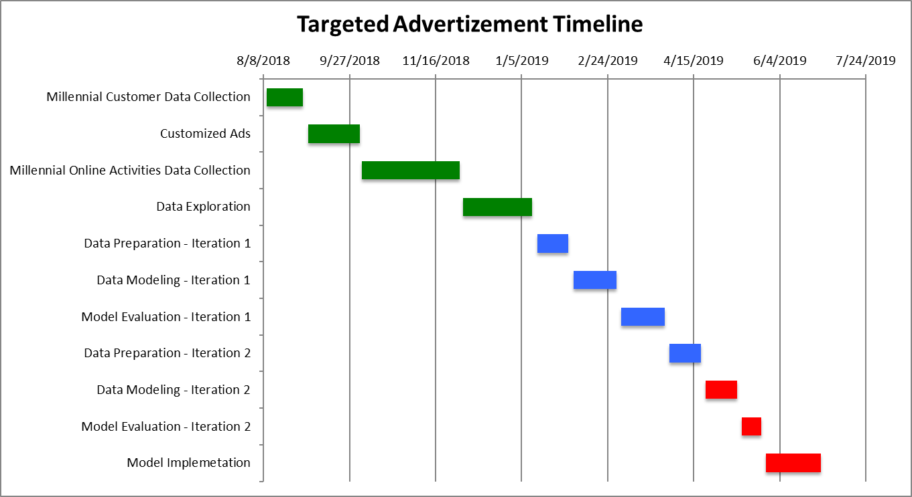
Team
1 Business Analyst: ($55,000 per year)
2 Digital Market Analyst: $45,000 per year each
1 Database Engineer: $90,000 per year
1 Compliance officer: $66,000 per year
2 Data scientist: $125,000 per year each
2 Data Analysts: $63,000 per year each
Full Implementation requires
9 employees and 11 roll out phases over a year
Cost and Impact Analysis
Business need
Conclusion
Executive summary
Risk and Mitigation
Analytical Proposal
Financials

Slide 7

Cost and Impact analysis
Business need
Conclusion
Executive summary
Financials
Analytical Proposal
Risk and Mitigation

Slide 8

Cost and Impact Analysis
Business need
Conclusion
Executive summary
Analytical Proposal
Financials
Risk and Mitigation

Slide 9
Cost and Impact Analysis
Business need
Conclusion
Executive summary
Analytical Proposal
Financials
Risk and Mitigation

Slide 10


Business need
Conclusion
Coast and Impact Analysis
Financials
Executive summary
Analytical Proposal
Risk and Mitigation

Slide 11


Business need
Cost and Impact Analysis
Executive summary
Analytical Proposal
Risk and Mitigation
Financials
Conclusion

Slide 12
Appendix
https://www.businessinsider.com/royal-caribbean-ceo-says-millennials-not-a-problem-for-cruise-line-2018-4
https://cruisearabiaonline.com/2017/07/11/industry-focus-how-cruise-lines-will-attract-millennials/
https://www.maritime-executive.com/article/attracting-millennials-to-cruising#gs.bmO=Cgw
https://www.cruising.org/docs/default-source/research/clia-2018-consumer-research.pdf?sfvrsn=0

